Slide 1


Customer Name
Month, Year

Slide 2

Today’s Discussion
Context
Objectives
Energy transition and ESG requirements are quickly shaping the future of the industry
Flowserve has been working with several of our Chemical, Petro-chemical and O&G customers to address the challenges, and opportunities associated with these trends
Through these efforts we have developed a set of innovative programs and solutions that have the potential to greatly benefit our customers
Review the changing industry landscape that is being shaped by energy transition and environmental related trends impacting you
Share Flowserve’s recent experience working with customers to address these challenges, and ensure future business and commercial success
Define the range of opportunity for you with estimated pump population and energy consumption data using the new innovative Flowserve Energy Advantage program and Solutions.
Agree whether Flowserve may partner with you to address energy efficiency of pumps and pump loops in a pilot project at _________
Tip - Modify objectives based on the customer and their eventual goals

Slide 3
Our Customers Are Facing A Variety of Challenges Where We Have Expertise
Industry Challenges
Increasing stakeholder pressure to “Decarbonize” & become more environmentally friendly
Business model and margins under pressure – requiring improvements in costs, efficiency, and reliability
Capex/assets under scrutiny – ROIC becoming increasingly important
Flowserve Expertise
Deep knowledge in flow loop and energy consumption optimization
Analytics & solutions that reduce operating costs, downtime and risks
Products and services that support “green” energy (e.g., bio diesel, blue/green hydrogen)
Solutions for carbon capture & sequestration

Slide 4
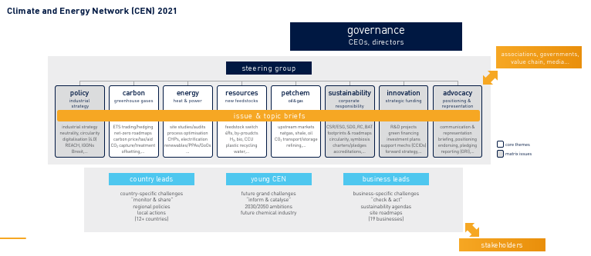
Customer Sustainability Report
Tip – Replace the above example with relevant elements of the sustainability report of the customer

Slide 5

Committed to Support our Customers Through our Experience & Expertise
Efficiency Advantage
Efficiency gains and significant operational savings from optimization of pump and valve energy consumption
FLOWSERVE
FULL ADVANTAGE PROGRAMS
Carbon Advantage
Reduce environmental impact and achieve sustainability goals by minimizing emissions and carbon footprint
Cost Advantage
Optimize operational expenses by increasing equipment reliability and reducing maintenance spend
Enabling customers to meet their sustainability objectives quickly with an extensive portfolio of solutions

Slide 6



Flowserve at a Glance
Over 50
Countries
~16,000
Employees
5,000,000+
Assets
(Installed Base)
Over 50
Leading
Product Brands
163
Aftermarket QRCs
(Quick Response
Centers)
10,000+
Customers Annually

Slide 7
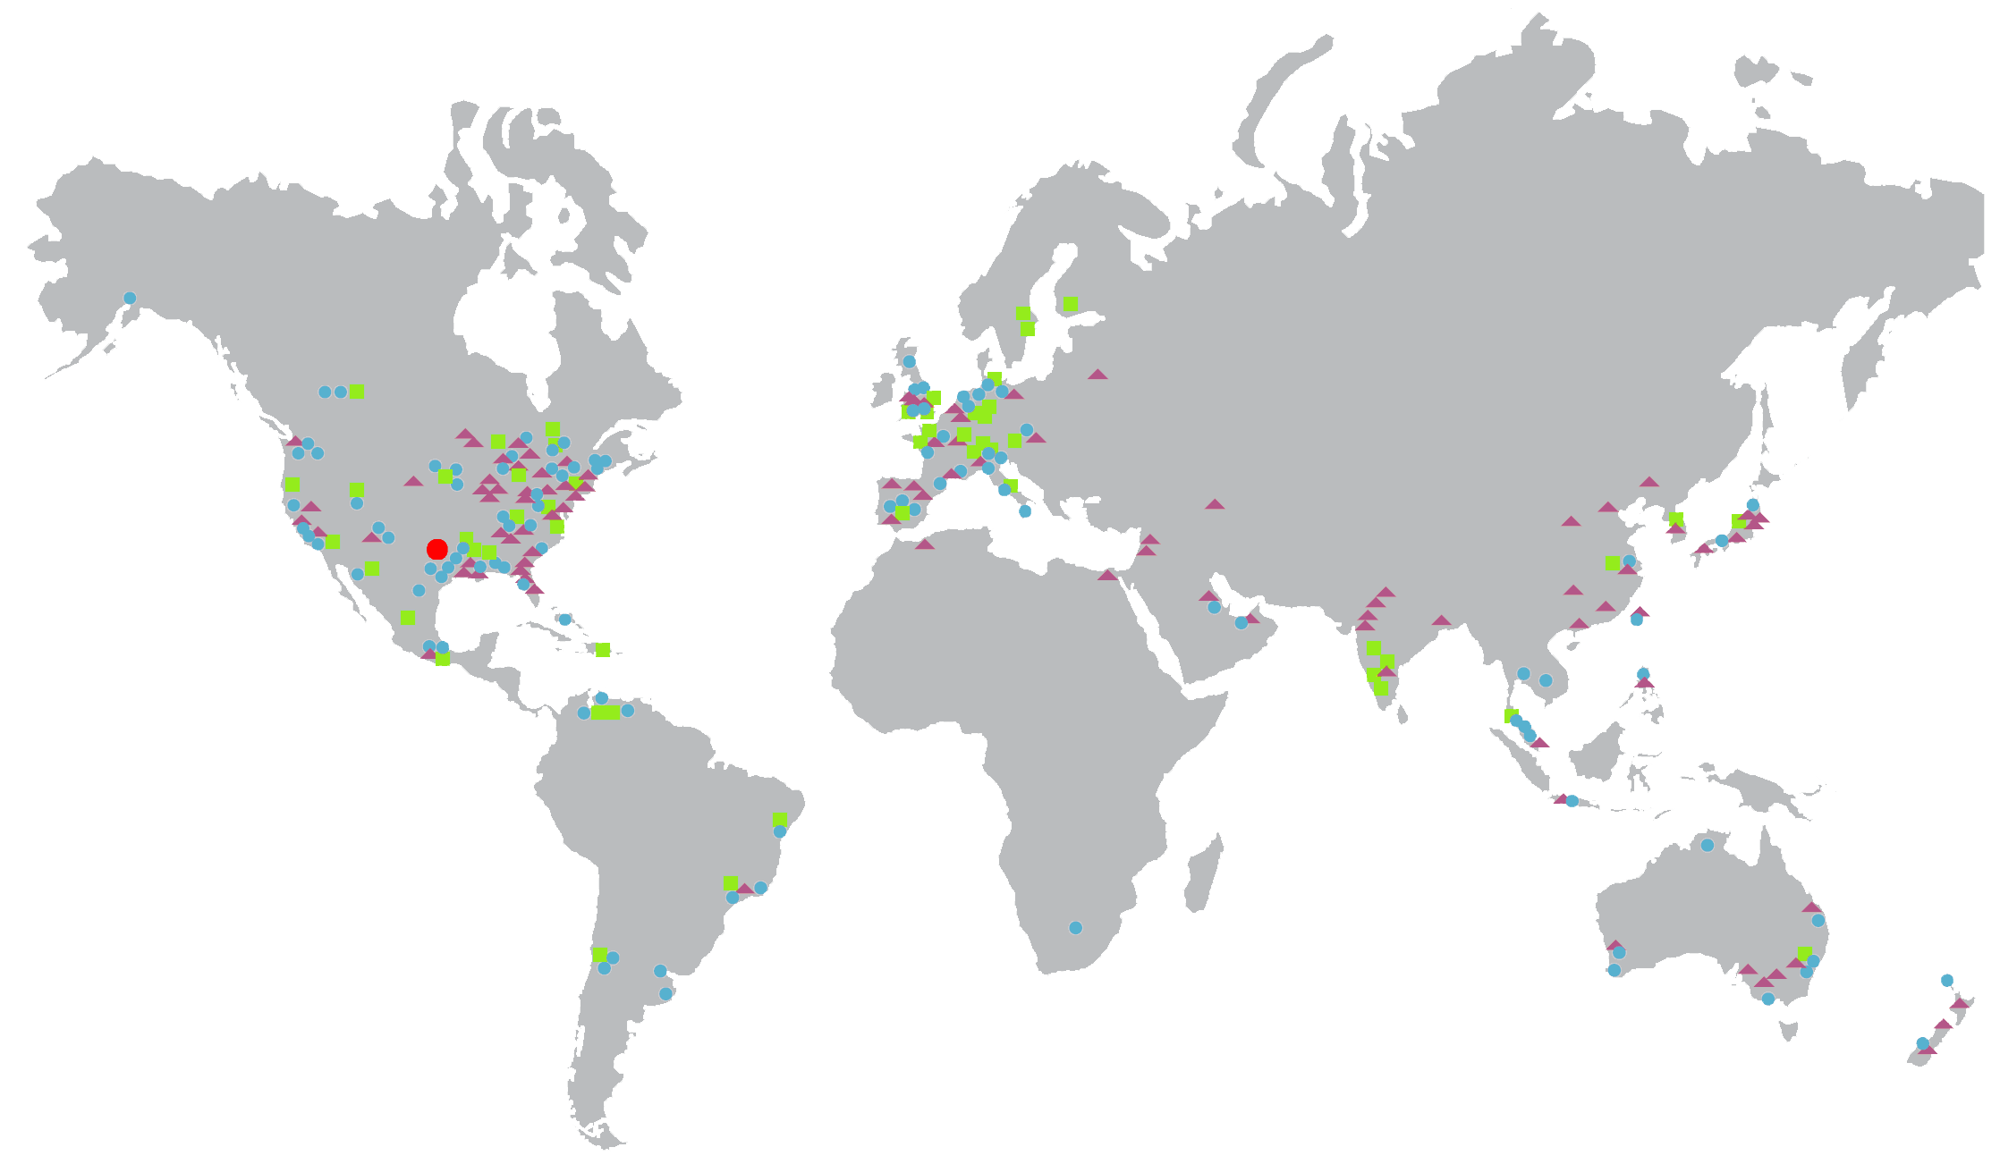
Global Reach and Local Presence
GLOBAL REACH
AND LOCAL PRESENCE
Flowserve people, processes and experience are keys to providing critical local support for customers in more than 50 countries. Flowserve has 180 quick response centers and 75 manufacturing facilities across the world.
*Excludes non-consolidated Joint Venture operations
World Headquarters
Sales Offices
Service Centers & Quick Response Centers
Manufacturing Plants & Regional Operations Centers

Slide 8



Company Overview
We develop and manufacture precision-engineered flow control equipment integral to the movement, control and protection of the flow of materials in our customers’ critical processes. Operations are conducted through these two operating units:
COMPANY OVERVIEW
Flowserve is a world-leading manufacturer and aftermarket service provider of comprehensive flow control systems.
Flowserve Pumps Division (FPD)
Provides custom, highly-engineered pumps, pre-configured industrial pumps, pump systems, mechanical seals, auxiliary systems and replacement parts and related services as well as a variety
of service offerings for our customers including seals, spare parts, service solutions, product life cycle solutions and other value-added services
Flow Control Division (FCD)
Provides engineered and industrial valves, control valves, actuators and controls and related services

Slide 9



3D Strategy is Our Vision for the Future
DIVERSIFY
DECARBONIZE
DIGITIZE
Diversify end markets and
create a more balanced
portfolio
Support our customers
today and through the
energy transition
Leverage technology and data
to improve internal operations,
customer experience and
9

Slide 10
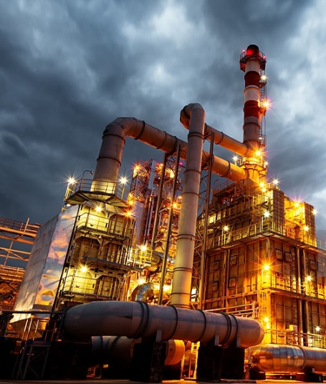
Efficiency Advantage Program – Flow Loop Optimization
Opportunity
Flowserve Solutions
Significant reduction in operational expenses by focusing on pump asset energy with additional benefit of reducing carbon footprint
Pump re-rating or replacement
Control Valve optimization/ replacements
Ongoing monitoring to sustain savings
Our Approach
Recent Case Study
Refinery pump Energy Efficiency Program
Analyze critical pump flow loops including control valves to gather data, devise and implement a contracting and execution model, adjust and monitor resultant savings
Challenge
Improve energy consumption for 15 critical service high energy pumps in a European refinery.
Solution
Optimized the flow loop by considering current and expected operating performance. Utilized Flowserve’s unique analysis tools to integrate pump and control valve optimization and to estimate data that was not available. Identified 35% energy savings for 15 pump items, with 13,600 MWh energy savings per year.
Pump Energy is up to ~50 to 60 % of a Refinery’s electrical energy usage* | Flowserve typically identifies 20-40% savings
*Energy Star Guide for Petroleum Refineries - Document Number 430-R-15-002

Slide 11
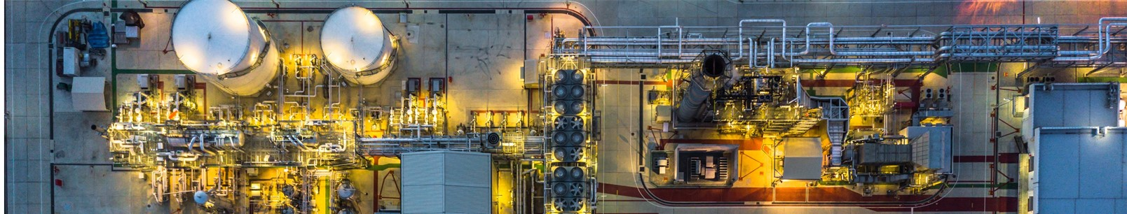

Energy Advantage Program Pilot
1
Select
4
Report
10-15 target pumps from pump population with High energy pumps as the focus
Deliver an execution program to meet agreed payback criteria
2
Evaluate
5
Execution
Potential for efficiency gains from thorough review of current operating conditions and required range of service
Agree to commercial approach for the program and resource with Program manager
3
Assess
6
Sustain
Integrating a cost advantage program for opportunities to correct production limiting or poor reliability pumps within the program
Create baseline of power consumption from which efficiency gains can be measured. Instrument and monitor equipment to provide sustainable savings

Slide 12

Estimated Opportunity
XX Pumps selected represent installed kW
Estimated Savings:
  XXX kWh
  $XXXX/Yr
  XXXX metric Tons/Yr CO2 savings
Assumptions:
  $0.056/kWh cost of power
  8,500 operating hrs/yr
  Pumps operate at 90% of motor nameplate power
  80% of pump flow loops will yield savings within acceptable payback timeframe
Tip1 – Replace above example with data relevant to the customer Tip2 - look at slide 9 for typical savings identified thorugh the program Tip 3 – assume 0.5 metric ton CO2/MWh

Slide 13
TITLE HERE
Instruction: Sell Your Proposal on this slide
Here you should demonstrate your understanding of the customer and your unique perspective on how to address their needs / challenges.

Slide 14
APPENDIX

Slide 15
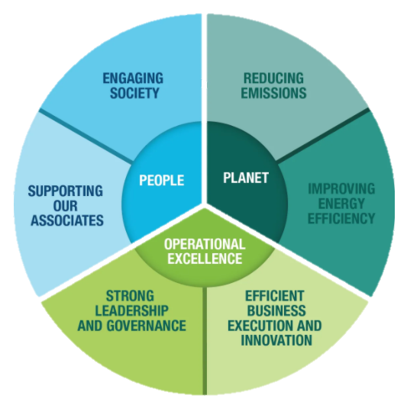

Building Sustainable Operations for Ourselves and our Customers
Our approach to sustainability is comprised of three key pillars – People, Planet and Operational Excellence:
People
Driving towards the goal of zero safety incidents to protect the health of our associates
Promoting a diverse and inclusive work environment
Responding to community needs where we operate
Planet
Increasing energy efficiency and reducing carbon emissions in our operations.
Providing the products and services that help customers improve efficiency
Conserving water and reducing waste
Tracking social and environmental metrics to gauge our progress
Operational Excellence
Operating in an ethical and socially responsible manner
Partnering with suppliers sharing similar commitment to ethics, human rights and environmental stewardship
Strong governance structure to manage risks
Sharing sustainability metrics data with stakeholders
As we work to meet our emissions commitments, Flowserve offers the Energy Advantage Program to our customers as a way to help them achieve their sustainability goals

Slide 16
Flowserve Carbon Reduction & Other Sustainability Metrics
Flowserve set a carbon reduction target to reduce operating carbon intensity 40% by 2030, using 2015 as a baseline year. As of December 2020, we have achieved 57% of the target.
In 2020, Flowserve completed 44 energy efficiency projects representing a 3.5% reduction in electricity usage.
72% of Flowserve’s discarded materials were recycled in 2020.
In 2020, Flowserve decreased its Total Recordable Incident Rate to 0.29 - the lowest in company history.
Through increased use of closed-loop processes, Flowserve has reduced freshwater consumption 18% since 2017.
All of Flowserve’s 60 global manufacturing facilities have obtained ISO 9001:2015 certification
Flowserve operates a global network of service centers allowing us to be closer to customer operations and reduce transportation related emissions
Through its “Flowserve Cares” program, Flowserve approved 23 grants to support at-risk youth, science and technology education, disaster recovery and other community needs.
Notes:
Key Talking Points:
Reduced carbon intensity by 40% - Majority reductions achieved from energy effieicny programs. In total, FLS has completed over 44 energy efficiency projects.
3.5% reduction in electricty usage – Achieved through the implementation of LED lighting in various faciilities and through the use and installation of compressed air systems, HVAC and Building management systems.
72% discarded material recycled – Implemented a program around recycling steel which reduces emissions through lower GHG released from the process. Additionally, FLS discourages discarding products that are close to the end of their lives and ensures that the products or parts are recycled and used in one form or the other.
18% fresh water consumption reduction – FLS utilizes a substantial amount of water for pump testing. We have implemented closed-loop processes which allows for the water discharged after the pump tests to be reused.
ISO 9001 certification – Ensures improved quality of products manufactured at FLS while reducing re-work. FLS has a dedicated quality program (Target Zero – Zero defects) that supports that.
Global QRC network – Our global network of quick response centers enable us to be in close proximity to our customer operations and allows for reduced transportation related emissions

Slide 17
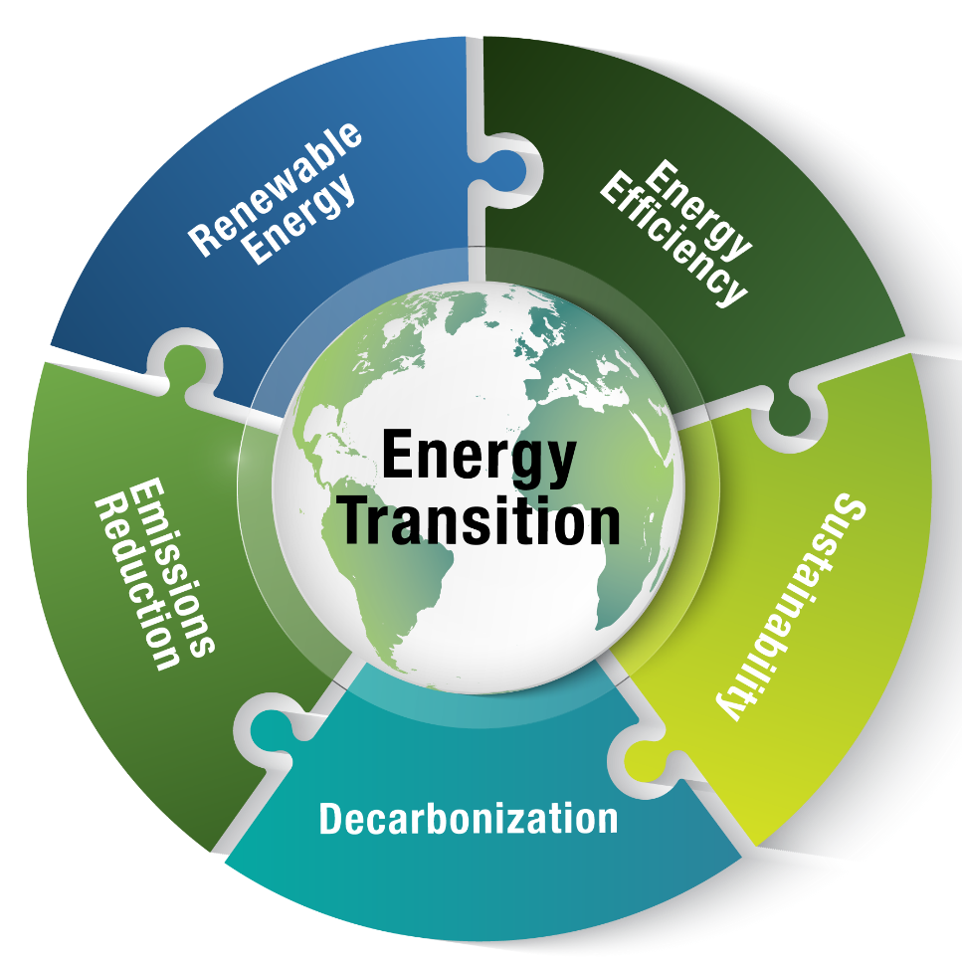
Navigating the Changing Energy Landscape
Knowing the Opportunities
Opportunities to improve sustainability & mitigate climate change
Expert Partners
Suppliers with the expertise to meet carbon reduction challenges
Value Adding Solutions
Solutions that ensure higher system safety, reliability and efficiency

Slide 18
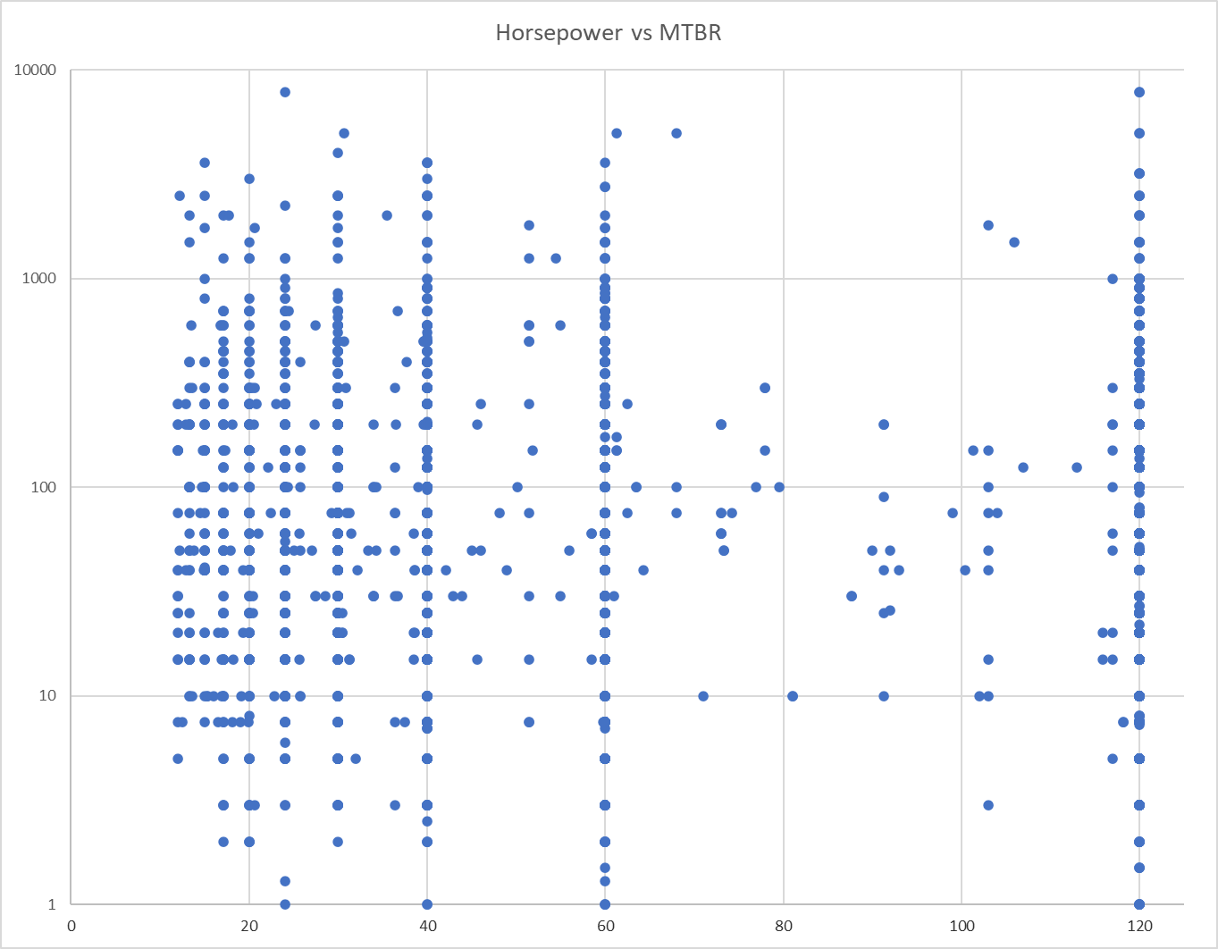
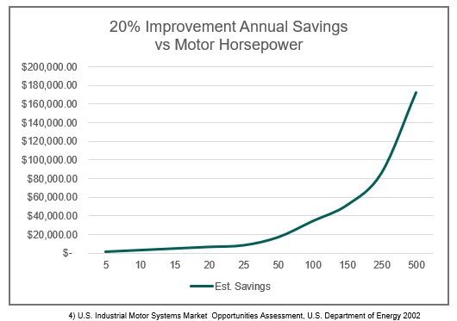
Identifying Energy Advantage Targets
Mapping exercise with all Customer assets
What will bring the most value?
  Energy
  Maintenance savings
  Lost Production avoidance

